Slide 1
DESI: Making Discoveries in the Dark
Sean MacBride

Slide 2

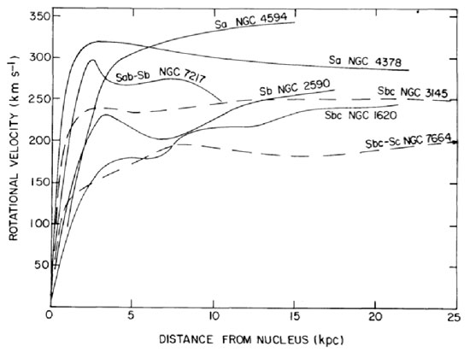
Cool things from the 80’s
Rubin et al. / ApJL 1978

Slide 3
Rubin’s discoveries led a revolution
Galaxy masses grow linearly with radius at large radii
Rubin’s results suggest either
Newtonian gravity does not apply universally
More than 50% of galactic mass resides in galactic halo
Results confirmed in later years, called “dark matter”
Rubin et al. / ApJL 1978

Slide 4
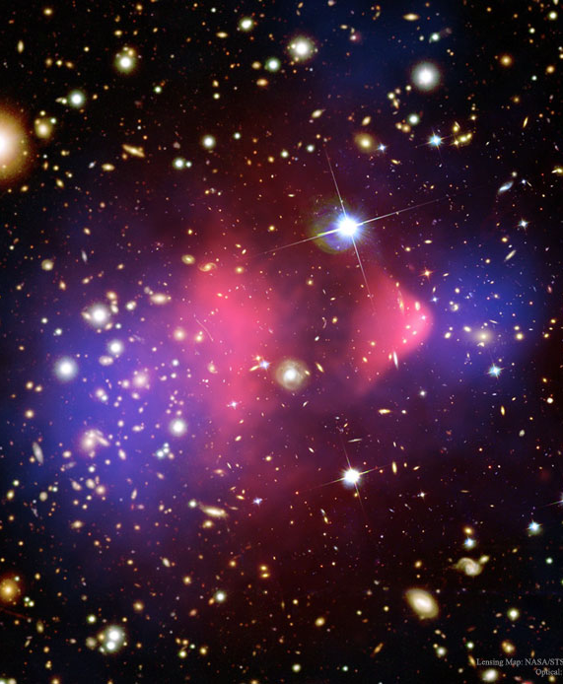
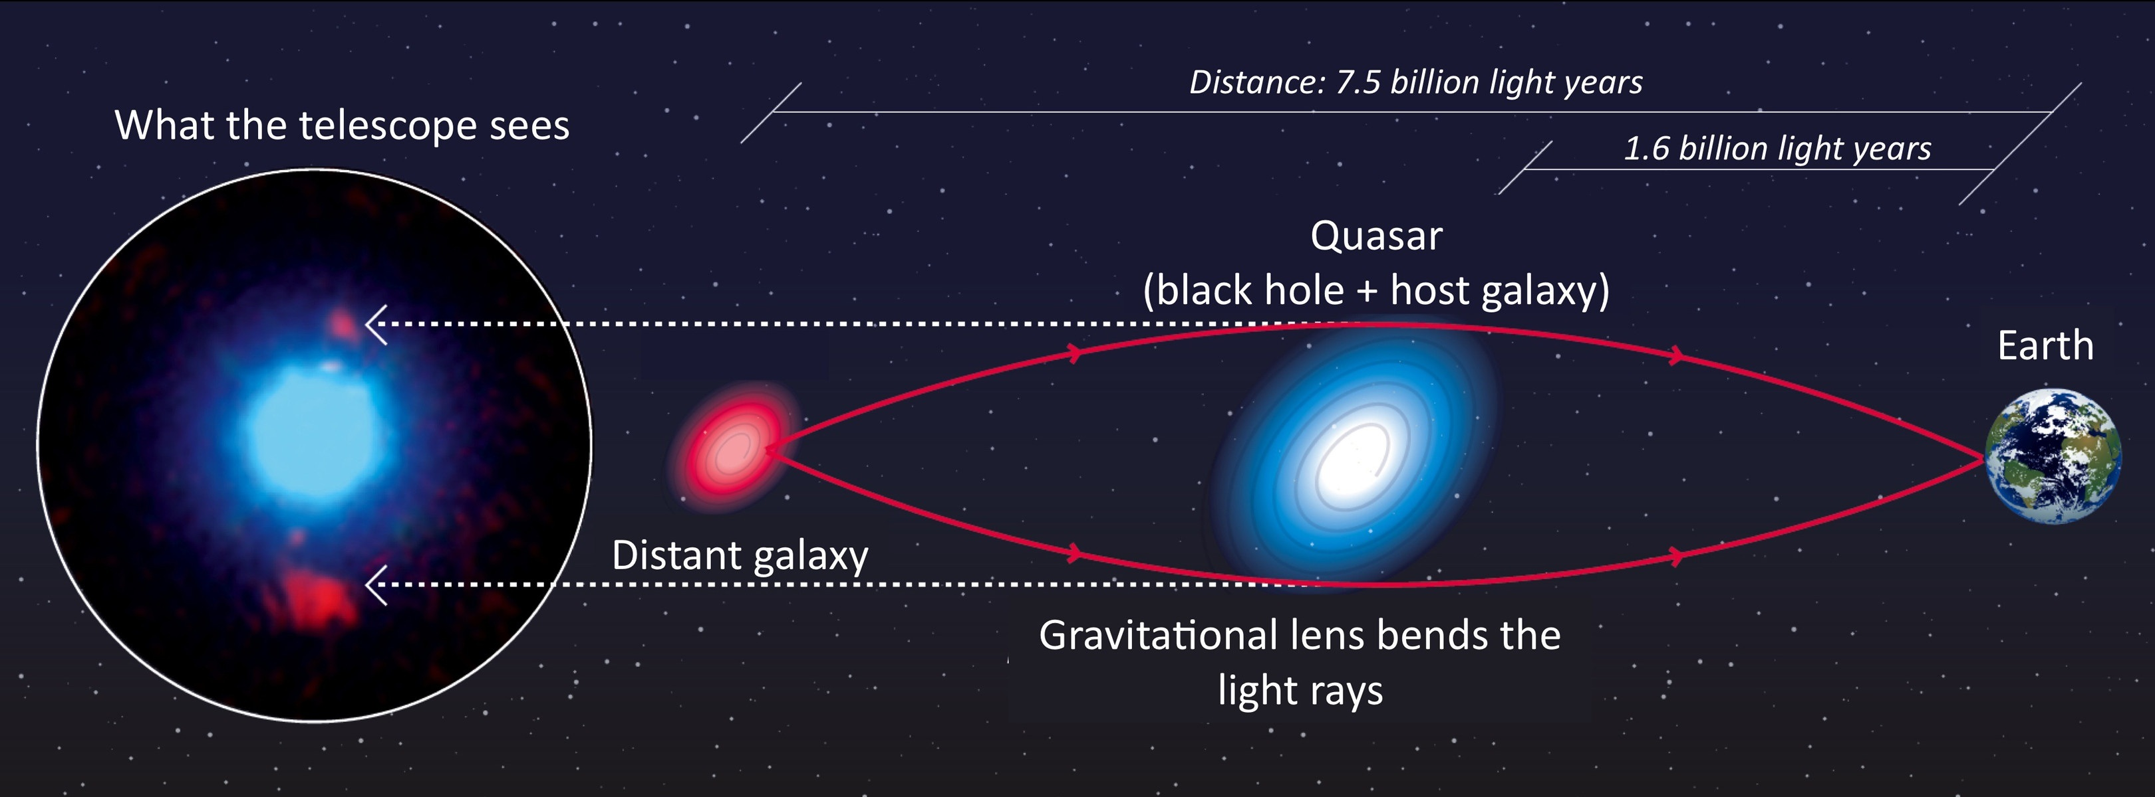
What is Dark Matter?
Dark Matter can only be studied indirectly
Does not emit light
No direct interaction with baryonic matter
Astronomy Stack Exchange
NASA/CXC/CfA/ M. Markevitch et al.

Slide 5
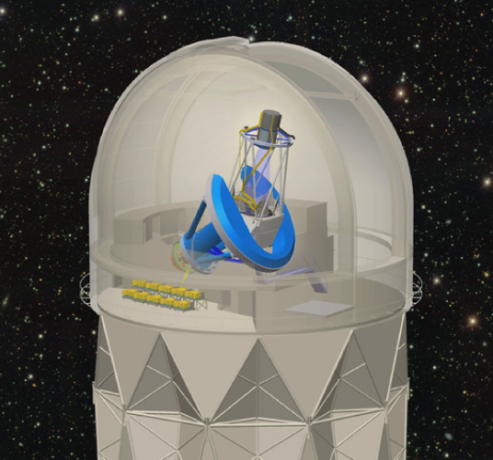
Dark Energy Spectroscopic Instrument
Located in Kitt Peak Arizona
Mounted on Mayall 4m telescope
Mapping BAO’s and redshift space distortions to unparalleled accuracy
Constrain current cosmological models
Desi.lbl.gov

Slide 6
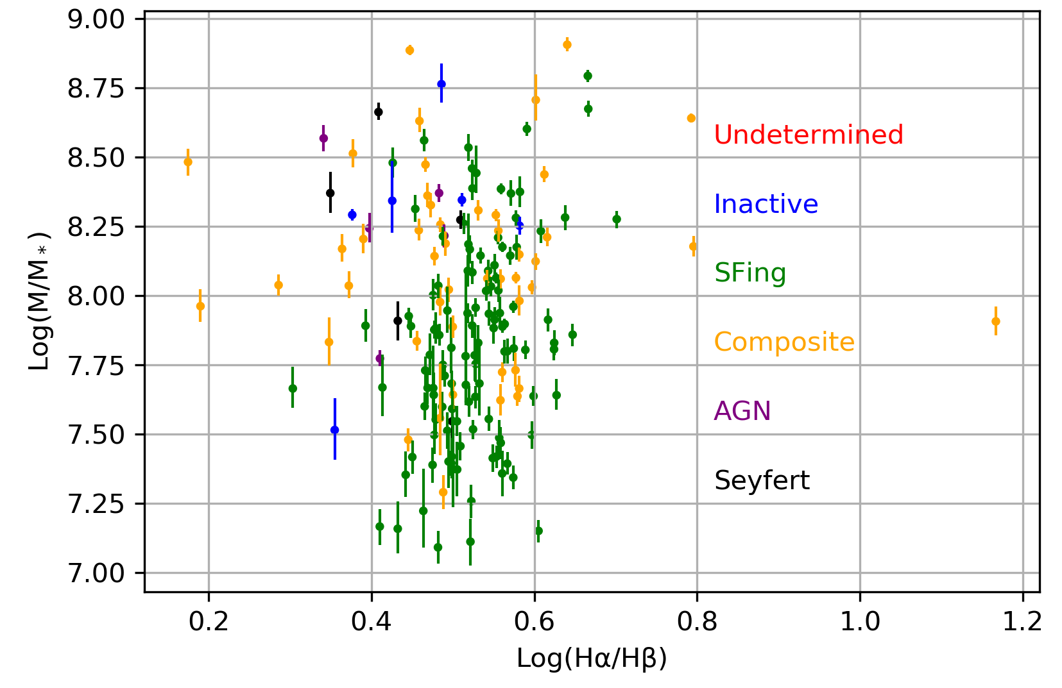
JINGLE and SDSS
JINGLE focuses on near galaxy ISM
Dust to gas mass ratios can be calibrated
SDSS can use luminosity to determine stellar mass

Slide 7
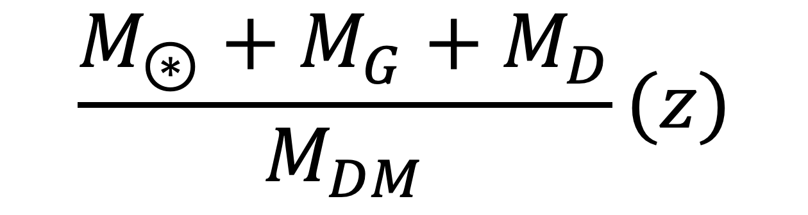
Baryonic Matter Fraction
$$\frac{M_{⊛}+M_{G}+M_{D}}{M_{DM}}(z)$$

Slide 8
Science Goals
Does the matter fraction evolve over time?
How does the matter fraction evolve?
Does the matter fraction evolve differently for different galaxy types?
Do any major epochs of cosmology leave an imprint on the evolution?
What particles could be interacting with dark matter?

